Slide 1
TOPIC III:
ENTREPRENEURIAL PROCESS

Slide 2
The Entrepreneurial Process
The process of creating something different, with value, by devoting necessary time and effort by assuming the accompanying financial, psychological and social risks, and receiving the resulting rewards of monetary and personal satisfaction
The Working Definition of Entrepreneurship according to Timmons, (1999: 27) is that “Entrepreneurship is a way of thinking, reasoning and acting that is opportunity obsessed, holistic in approach [emphasis added], and leadership balanced”.

Slide 3

The Entrepreneurial Process (Timmons, 2000)
Communication
Opportunity
Resources
Business Plan
Fits and Gaps
Ambiguity
Exogenous Forces
Creativity
Leadership
Team
Uncertainty
Capital Market Forces
Founder

Slide 4
The Entrepreneurial Process
Analysis
Eval., Review,
& Feedback
Implementation
Strategy
Formulation

Slide 5
The Life Cycles of an Entrepreneur
Entrepreneurial ventures evolve over time through various stages from start-up, development and growth through to decline and closure. The enterprise changes its characteristics in each of these stages in a way that often requires different skills, structures and resources to manage them.
A number of models or ways of categorising and predicting these characteristics have been put forward in order to conceptualise the life cycle of an enterprise from start to finish.

Slide 6
Greiner (1972) developed an early model of evolution and revolution in the growth of an organization. In his 1998 Harvard Business Review article entitled “Evolution and Revolution as Organizations Grow,” Greiner outlined five phases of growth punctuated by what he termed “revolutions” that shook up the status quo and ushered in the successive stage. The five phases are creativity, direction, delegation, coordination and collaboration.
Churchill and Lewis (1983) identified the stages of: existence; survival, success, take-off and maturity. Scott
Bruce (1987) described the five stages as: inception, survival, growth, expansion and maturity.
In each of these stages, they suggest that the role of the top manager, the style of management and the organizational structure will change accordingly.

Slide 7
Greiner’s Model of organizational growth is based on the following assumptions about the organization namely;
That organisations are rigid, bureaucratic, control-centric, and centralized entities.
That organisations fail to see that the future success of an organisation lie within their own organisation,
That organizations fail to assess their evolving states of development.
Therefore inability of a management to understand its organisation development problems can result in organisation becoming frozen in its present stage of evolution (failure to evolve) regardless of market opportunities

Slide 8
Before discussing the Greiner’s Model of organizational growth, first let us define the two terms: evolution and revolution.
Evolution is used to describe prolonged period of growth ­ where no major upheaval occurs in organisation practices.
The term revolution is used to describe those periods of substantial turmoil in organisational life.
Each evolutionary period creates its own revolution, as organisation progresses through developmental phases.
For instance centralized practices eventually lead to demand for decentralization. Moreover the nature of management’s solution to each evolutionary period determines whether organisation will move forward into next stage of evolutionary growth.

Slide 9
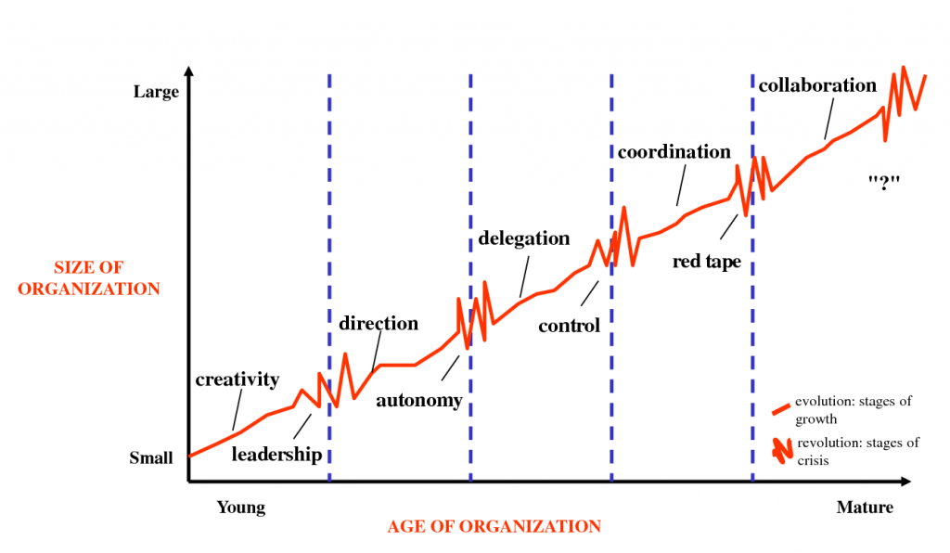
Five Phases in Greiner’s Model of Organizational Growth

Slide 10
A composite life cycle model
Phase 5
Re-growth/ Decline
Phase 4
Maturity
Phase 3
Growth/ Decline
Measure of growth (e.g. Sales
Phase 2
Development/ Abort
Phase 1
Concept/ Test
12
24
36
48
60
Time (e.g. Months

Slide 11
Stage 1: Concept/Test/Creativity Stage
Before a business is launched, it undergoes some form of conception and planning.
This may involve a market test or running the business as a part-time operation, before the owner places complete dependence on it.
Creative thinking, information gathering and networking are key activities in this stage.
This phase is dominated by the entrepreneurs of the organizations and the emphasis is on creating both a product and a market.

Slide 12
However, as the organization grows in size and complexity, the need for greater efficiency cannot be achieved through informal channels of communication.
Thus, many managerial problems occur which the entrepreneur may not solve effectively because they may not be suited for the kind of job or they may not be willing to handle such problems.
Thus, a crisis of leadership emerges and the first revolutionary period begins. Such questions as ‘who is going to lead the organisation out of confusion and solve the management problems confronting the organization; who is acceptable to the entrepreneurs and who can pull the organisation together arise. In order to solve the problems a new evolutionary phase – growth through direction begins.

Slide 13
Stage 2: Development/abort stage/ Direction stage
The business is launched and either develops to a viable size, or it is aborted at an early stage.
This will depend critically on whether sufficient customers in the marketplace adopt the product or service on offer, hence marketing linked to cash flow management are often the key functional activities.
Typically an individual entrepreneur manages the enterprise in this stage largely through their own efforts.
This is a particularly vulnerable stage for a business as statistics indicate that it is the smallest and youngest firms that have the highest rates of closure.

Slide 14
In this stage is when leadership crisis leads to the entrepreneurs relinquishing some of their power to a professional manager, organizational growth is achieved through direction.
During this phase, the professional manager and key staff take most of the responsibility for instituting direction, while lower level supervisors are treated more as functional specialists than autonomous decision making managers.
Thus, directive management techniques enable the organisation to grow, but they may become ineffective as the organisation becomes more complex and diverse.
Since lower level supervisors are most knowledgeable and demand more autonomy in decision making, a next period of crisis – crisis of autonomy begins.
In order to overcome this crisis, the third phase of growth – growth through delegation emerges.

Slide 15
Stage 3: Growth/decline stage/ Delegation stage
Some enterprises that have developed into a viable entity in the marketplace continue their growth quickly or, in some cases, more steadily.
Such growth may place strains on the internal structure of the enterprise. The management of internal processes and people are often the critical functions.
The one-person entrepreneurial management style may prove inadequate to fully sustain growth.
A division of managerial tasks, the recruitment of non-owner-managers and the development of a functionally organised team are often prerequisites to take a business through this phase, without which it may struggle and close.

Slide 16
In this stage, resolution of crisis for autonomy may be through powerful top managers relinquishing some of their authority and a certain amount of power equalization.
However, with decentralization of authority to managers, top executives may sense that they are losing control over a highly diversified operation.
Field managers want to run their own show without coordinating plans, money, technology or manpower with the rest of the organisation and a crisis of control emerges.
This crisis can be draft with the next evolutionary phase – the coordination stage.

Slide 17
Stage 4: Maturity/ Coordination Stage
Most surviving business go through a period of stability, when growth flattens and the enterprise matures.
It may at this stage lose its simple structure of centralized decision-making, use more sophisticated business processes and become more bureaucratic in its procedures.
In other words, it takes on some of the characteristics of a larger organization.

Slide 18
In this stage, the coordination phase is characterized by the use of formal systems for achieving grater coordination with top management as the watch dog.
The new coordination system proves useful for achieving growth and more coordinated efforts by line managers, but result in a task of conflict between line managers and staff, between head quarters and field.
Line managers becomes resentful to staff, staff complains about un-cooperative line managers, and everyone gets bogged down in the bureaucratic paper system.
Procedure takes precedence over problem solving; the organization becomes too large and complex to be managed through formal programmes and rigid systems.
Thus, crisis of red – tape begins. In order to overcome the crisis of red-tape, the organization must move to the next evolutionary stage – the collaboration stage

Slide 19
Stage 5: Re-growth/decline/ collaborative stage
Once an enterprise has established itself in the marketplace with a competitive advantage over its rivals, profits or external investment may be available to exploit further the successful business model.
The so-called ‘s-curve hypothesis’ suggests that such investment may trigger a second period of growth.
Without this further period of growth, the maturity stage can turn into stagnation and decline, as competition intensifies from existing rivals or new entrants into the market.

Slide 20
This Collaboration stage involves more flexible and behavioral approaches to the problems of managing a large organisation.
While the coordination stage was managed through formal systems and procedures, the collaboration stage emphasizes greater spontaneity (freedom) in management action through teams and skillful confrontation of interpersonal differences.
Social control and self-discipline take over from formal control.
Though Greiner is not certain what will be the next crisis because of collaboration stage, he feels that some problems may emerge as it will center round the psychological saturation of employees who grow emotionally and physically exhausted by the intensity of team work and of the heavy pressure for innovating solutions.

Slide 21
Limitations of Life Cycle Model
Several commentators (Storey, 1994; Deakins, 1996) have pointed out that such stage models have considerable limitations as predictors of enterprise development and growth:
Growth is rarely as smooth as the curve of the graph suggests. It is more likely to represent spikes of growth and contraction rather than rounded peaks. For example many small businesses have relatively few customers, so that the addition of one new significant client will lead to a sudden growth spurt. Conversely, the loss of one large client can significantly shrink the size of the business.

Slide 22
The transition from one stage to another does not necessarily take place in the order predicted by the model. Economic or trade cycles outside the control of the firm may contribute substantially to the growth or decline of an enterprise at any time irrespective of the stage of development.
The contention that the transition from one stage to the next is triggered by a particular kind of crisis has not been tested through empirical research. The development of an enterprise is likely to be subject to many different internal and external variables so that isolating one primary cause for the evolution of a firm from one stage to another is an over-simplification of a very complex process.
Many enterprises reach a stable size and never make the transition out of this phase. Once they have developed a business to a stage of survival, life-style entrepreneurs will have little motivation to grow it further.

Slide 23
Conclusion
According to Greiner’s Model, every structure is valid for a specific time period and organizational change triggers radical structure changes.
Changing organizational structure solves the problems in that time, and prepares infrastructure for the problems may occur in the future.
Greiner’s Model is a useful way of thinking about the crises that organizations experience as they grow.
By understanding it, managers can quickly understand the root cause of many of the problems likely to experience in a fast growing business.
More than this, managers and strategists can anticipate problems before they occur, so that you can meet them with pre-prepared solutions.

Slide 24
The Entrepreneur
The characteristics of the entrepreneur are widely accepted as the vital ingredient that influences growth.
Research indicates that the particular characteristics of the entrepreneur that are associated with growth of the enterprise include:
a) Motivation: if the entrepreneur’s reasons for starting the business originated in ‘pull’ or ‘opportunity-driven’ motives such as the desire to exploit a market opportunity, rather than ‘push’ or ‘necessity-driven’ motives such as unemployment, then the resulting enterprise is more likely to grow. The commitment of the entrepreneur to growth makes a considerable difference.

Slide 25
b) Previous management experience: prior experience of managing people and processes is valuable in maintaining growth.
c) Demographics of the entrepreneur: age and education can influence growth. Some research suggests that middle-aged founders benefiting from some experience yet still retaining the energy necessary to drive a business forward are more likely to grow their business.
Similarly, Entrepreneurs with higher educational qualifications are more likely to found high-tech and knowledge-based firms which tend to be linked with higher rates of growth.

Slide 26
d) Number of entrepreneurs involved: enterprises founded by a group of entrepreneurs are more likely to grow than one-person bands. Access to a wide range of skills, experiences and resources is important to growth, and an entrepreneurial team is more likely to possess the attributes needed than just one person.
Other characteristics influencing growth including:
Family history;
Training and functional skills;
Gender;
Social marginality; and
Experience of the sector.

Slide 27
Transitioning from Entrepreneurial to Managerial
Impediments to Transition:
  A highly centralized decision-making system
  An overdependence on one or two key individuals
  An inadequate repertoire of managerial skills and training
  A paternalistic atmosphere

Slide 28
The Entrepreneurial Culture versus the Administrative Culture
 | Entrepreneurial Focus |  | Administrative Focus
 | Characteristics | Pressures | Characteristics | Pressures
Strategic Orientation | Driven by perception of opportunity | Diminishing opportunities Rapidly changing technology, consumer economics, social values, and political rules | Planning systems and cycles | Social contracts Performance measurement criteria
Commitment to Seize Opportunities | Revolutionary, with short duration | Action orientation Narrow decision windows Acceptance of reasonable risks Few decision constituencies | Evolutionary, with long duration | Acknowledgement of multiple constituencies Negotiation about strategic course Risk reduction Coordination with existing resource base
Commitment of Resources | Many stages, with minimal exposure at each stage | Lack of predictable resource needs Lack of control over the environment Social demands for appropriate use of resources Foreign competition Demands for more efficient use | A single stage, with complete commitment out of decision | Need to reduce risk Incentive compensation Turnover in managers Capital budgeting systems Formal planning systems
Control of Resources | Episodic use or rent of required resources | Increased resource specialization Long resource life compared with need Risk of obsolescence Risk inherent in the identified opportunity Inflexibility of permanent commitment to resources | Ownership or employment of required resources | Power, status, and financial rewards Coordination of activity Efficiency measures Inertia and cost of change Industry structures
Management Structure | Flat, with multiple informal networks | Coordination of key noncontrolled resources Challenge to hierarchy Employees’ desire for independence | Hierarchy | Need for clearly defined authority and responsibility Organizational culture Reward systems Management theory

Slide 29
Balancing the Focus: Entrepreneurial versus Managerial
The Entrepreneur’s Point of View
  Where is the opportunity?
  How do I capitalize on it?
  What resources do I need?
  How do I gain control over them?
  What structure is best?
The Administrative Point of View
  What resources do I control?
  What structure determines our organization’s relationship to its market?
  How can I minimize the impact of others on my ability to perform?
  What opportunity is appropriate?

Slide 30
Understanding the Growth Stage
Key Factors During the Growth Stage
  Control
    Does the control system imply trust?
    Does the resource allocation system imply trust?
    Is it easier to ask permission than to ask forgiveness?
  Responsibility
    Creating a sense of responsibility that establishes flexibility, innovation, and a supportive environment.
  Tolerance of failure
    Moral failure
    Personal failure
    Uncontrollable failure
  Change

Slide 31
Managing Paradox and Contradiction
Bureaucratization versus decentralization
Environment versus strategy
Strategic emphases:
Quality versus cost versus innovation

Slide 32
Confronting the Growth Wall
Successful growth-oriented firms have exhibited consistent themes:
  The entrepreneur is able to envision and anticipate the firm
  as a larger entity.
  The team needed for tomorrow is hired and developed today.
  The original core vision of the firm is constantly and zealously reinforced.
  New “big-company” processes are introduced gradually as supplements to, rather than replacements for, existing approaches.
  Hierarchy is minimized.
  Employees hold a financial stake in the firm.

Slide 33
Handling Environmental Changes and Trends
Internal Constraints on Managing Growth
  Lack of growth capital
  Limited spans of control
  Loss of entrepreneurial vitality
Key Steps in Managing Growth and Change:
  Creating a growth task force
  Planning for growth with strategies
  Maintaining a growth culture
  Developing an outside board of advisors

Slide 34
Building an Entrepreneurial Company in the Twenty-First Century
Building Dynamic Capabilities:
  Internally—through the utilization of the creativity and knowledge from employees
  Externally—through the search for external competencies to complement the firm’s existing capabilities
What Entrepreneurs Do:
  Perceive a unique opportunity
  Pursue the opportunity
  Believe that success of the venture is possible

Slide 35
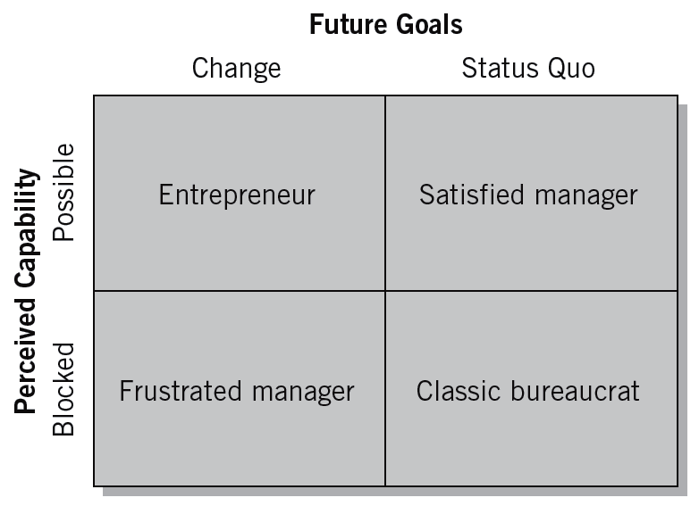
The Entrepreneurial Mind-Set

Slide 36
The Managerial versus the Entrepreneurial Mind-Set
 | Managerial Mind-Set | Entrepreneurial Mind-Set
Decision-making assumptions | The past is the best predictor of the future. Most business decisions can be quantified. | A new idea or an insight from a unique experience is likely to provide the best estimate of emerging trends.
Values | The best decisions are those based on quantitative analyses. Rigorous analyses are highly valued for making critical decisions. | New insights and real-world experiences are more highly valued than results based on historical data.
Beliefs | Law of large numbers: Chaos and uncertainty can be resolved by systematically analyzing the right data. | Law of small numbers: A single incident or several isolated incidents quickly become pivotal for making decisions regarding future trends.
Approach to problems | Problems represent an unfortunate turn of events that threaten financial projections. Problems must be resolved with substantiated analyses. | Problems represent an opportunity to detect emerging changes and possibly new business opportunities.

Slide 37
Key Elements for an Entrepreneurial Firm
An Entrepreneurial Firm
  Increases opportunity for its employees, initiates change, and instills a desire to be innovative.
How to remain adaptive and innovative:
  Share the entrepreneur’s vision
  Increase the perception of opportunity
  Institutionalize change as the venture’s goal
  Instill the desire to be innovative:
    A reward system
    An environment that allows for failure
    Flexible operations
    The development of venture teams

Slide 38
Unique Managerial Concerns of Growing Ventures
Distinctiveness
of Small Size
One-Person-Band
Syndrome
Continuous
Learning
Growing Venture
Time
Management
Community
Pressures

Slide 39
CREATIVITY AND INNOVATION
Creativity is thinking new things, and innovation is doing new things
Creativity is the ability to develop new ideas and to discover new ways of looking at problems and opportunities.
Innovation is the ability to apply creative solutions to those problems and opportunities in order to enhance people’s lives or to enrich society
Entrepreneurship = creativity + innovation

Slide 40
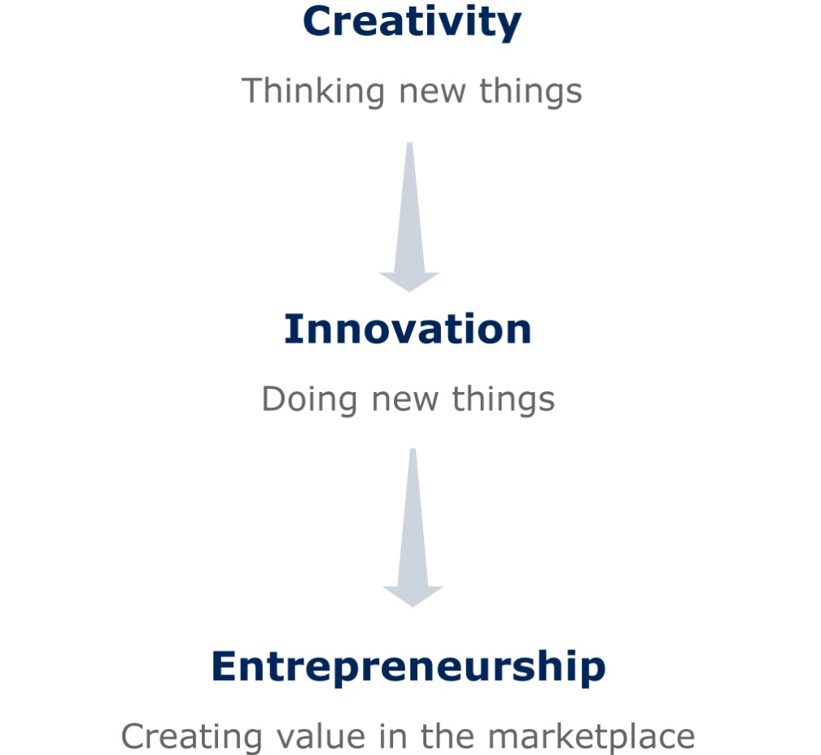
From Creativity to Entrepreneurship

Slide 41
Creativity Vs Innovation
Creativity is the ability to bring something new into existence
Creativity is thinking new things
The outcome of creativity is a new idea
Creativity is the seed that inspires entrepreneurship
Creativity is the ability to create new, original ideas
Innovation is the activity (process) of bringing a new product or service into market
Innovation is doing new things
The outcome of innovation is a new product or service or process
Innovation is the process of entrepreneurship
Innovation is the transformation of those creative ideas into useful application (new products, services or processes)

Slide 42
For example;
Bill Gates transformed his creative idea into Microsoft Office
Right Brothers transformed their creative idea into Aero plane
Alexander G. Bell transformed his creative idea into Telephone
James Cameron transformed his creative idea into the blockbuster move Titanic
Therefore, an idea has value unless it is transformed into a tangible product, service or business venture. If an entrepreneur is not creative, he cannot innovate anything. Thus without a new/ creative idea, innovation is not possible. So we can say that, “Creativity is a prerequisite to innovation

Slide 43
5 Steps in the Creative Process Model
Stage I-Preparation: an individual becomes curious after encountering a problem.
An individual formulates the problem and collects facts and materials necessary for finding new solutions
Examples of problems can include an artistic challenge or an assignment to write a paper. During this stage, a person performs different ideas such as formulate research, create goals, organize thoughts and brainstorm
For example, a marketing professional may prepare for a marketing campaign by conducting market research and formulating different advertisement ideas.
So this stage is normally best carried out in a quiet environment because this information will go into your sub-consciousness

Slide 44
Stage II-Incubation: During this period some of the ideas that were interfering with the solution in the preparation stage will tend to fade.
The unconscious thought process of finding a solution to the problem.
The overt activity and sometimes even thinking about the problem is absent in this stage.
The individual does not actively try to find a solution, but continues to mull over the idea in the back of her head
It is something you cannot really rush because what it leads to is the third stage.

Slide 45
Stage III- Insight: With insight it is really the idea of the ‘Aha’ moment.
As ideas begin to mature, the individual has an epiphany regarding how to piece her thoughts together in a manner that makes sense
This moment most often happen when you are doing some kind of low-level physical activity; going for a shower, driving a car, having a walk etc.
This is because your sub-consciousness in the previous stages is bubbling away and this insight stage really allows the mind to work on something else.
And then bring these ideas to the forefront of your mind.

Slide 46
Stage IV-Evaluation: Here a lot of creative people struggle because they have so many ideas with limited amount of time.
So the evaluation stage is important because this is where it requires self-criticism and reflection. It is asking yourself questions like:
“Is this a novel or new idea or is it one that is just re-hashed and has been done before?”
It’s the idea of going out to a small group of trusted friends and saying:
“I’ve had this idea, what do you think about this?”
It is very important part because we only have a limited amount of time to do certain things.
They have all these ideas but they can use self-criticism and reflection to say “these are the ones that have the most merit and that I’m going to work on”

Slide 47
Stage V-Implementation: This is where Edison said that it’s “1% inspiration and 99% perspiration (sweat)”. Now the elaboration stage is the 99% perspiration stage.
An individual begins the process of transforming his (her) thoughts into a final product.
For example, during this step, a painter may begin outlining shapes on a wall with charcoal before applying oil paints to the medium.
At this stage, testing the idea, working on the idea, those late nights in the studio, working at your desk, those hours in the laboratory if you are scientist, those days testing and micro-testing products.

Slide 48
The 3 Keys to Creative Thinking Process
In-the-box: This applies knowledge accumulation and critical thinking to the problem. Based on their expertise, innovators can generate many relevant ideas and make connections later.
Out-of-the-box: This is a wide-angle and unfocused thinking process. It allows the innovators to imagine an entire universe of possibilities.
New-box: Once ideas are evaluated, they need to be synthesized by rearranging and reconstructing through dot-connecting, then refined and put into place in a new context.

Slide 49
Principles of Creativity Process in Entrepreneurship
1. Define and Distill the Problem: Einstein once said that “If I had 20 days to solve a problem, I would take 19 days to define it.” The things we create are not monolithic, but combinations of components. So if you’re searching for creative solutions, it’s important that you frame and target an area ripe for innovation. Creativity doesn’t happen in a vacuum.
2. Learn the Rules before you set out to break them: While we commonly view creativity as the product of brilliant flashes, the reality is exactly the opposite. Creativity comes only after years of preparation. It takes deliberate practice, which involves working on weak areas, seeking out feedback and continual improvement. No day at the beach! Successful creative people spend years learning their fields before they begin to change them.

Slide 50
3. Cross Domains: While deep knowledge of a specific field is important, it is not enough. In fact, research suggests that many professionals actually get worse over time. Just as familiarity breeds contempt, constant exposure to similar fact patterns produces lazy thinking.
Hedge/ evade your bets: We often see great innovators as big dreamers, who through caution to the wind and bet everything on one big idea. The reality is much more complicated than that. Take Einstein’s miracle year in which he unleashed three papers which changed the world.
In one, he proved the existence of the atom by explaining Brownian motion.
In another, he described the photoelectric effect and proposed the existence of light quanta.
The third was his famous paper of special relativity.
His primary objective wasn’t to change history, but to get a job as a university professor!

Slide 51
5. Keep at it: Creativity is not something that comes easy, even to geniuses. For instance a study of musicians found that the number of masterpieces produced is highly correlated to overall productivity. The more work you do, the better your work gets.
The Most Common Idea “Killers”
“Naah.”
“Can’t” (said with a shake of the head and an air of finality).
“That’s the dumbest thing I’ve ever heard.”
“Yeah, but if you did that . . .” (poses an extreme or unlikely disaster case).
“We already tried that—years ago.”
“I don’t see anything wrong with the way we’re doing it now.”
“We’ve never done anything like that before.”
“We’ve got deadlines to meet—we don’t have time to consider that.”
“It’s not in the budget.”
“Where do you get these weird ideas?”

Slide 52
Benefits of creativity
Creating new ideas for competitive advantage: The whole process of entrepreneurship is rooted in creation and exploration of new ideas. When an entrepreneur is able to generate a new idea that is feasible as well as efficient, it gives him an edge over the competition.
Thinking of novel ways to develop your product and improve the business: Creativity helps develop new ways of improving an existing product or service and optimizing a business. There is always a room for improvement in the deliverables of an enterprise.
Thinking the unthinkable: Creativity requires imagination to produce the most obscure/ vague ideas. Imagination is needed to cross the boundary of “usual” and “normal” or to think outside the box.
Finding similar patterns in different areas: Sometimes, due to following a routine or a habit, the thinking process also goes along the line of those established processes. Creativity enables people to connect dissimilar and unrelated subjects and make successful entrepreneurial ideas. Most people are afraid of bringing different disciplines together, but most interesting ideas come from colliding different fields.
Developing new niches through creativity and entrepreneurship: In entrepreneurship, it is important that new aspects of traditional business are explored. This can be in the form of changing the method of manufacturing the product or delivering the service or how are they supplied to the user.

Slide 53
Innovation
Innovation is means by which Entrepreneurs exploit change as an opportunity for a different business or a different service.
Is the process by which entrepreneurs convert opportunities into marketable ideas.
Is a combination of the vision to create a good idea and the perseverance and dedication to remain with the concept through implementation.
Is a key function in the entrepreneurial process.
Is the specific function of entrepreneurship

Slide 54
Today it is said to involve the capacity to quickly adapt by adopting new innovations (products, processes, strategies, organization, etc)
Also, traditionally the focus has been on new products or processes, but recently new business models have come into focus, i.e. the way a firm delivers value and secures profits.
Schumpeter argued that innovation comes about through new combinations made by an entrepreneur, resulting in
  a new product,
  a new process,
  opening of new market,
  new way of organizing the business
  new sources of supply

Slide 55
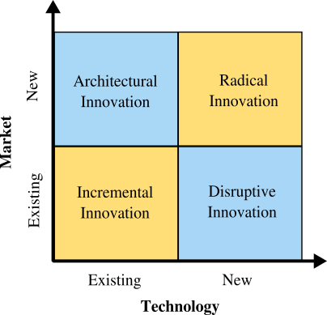
Types of Innovation Process
Innovation can be broken down into two dimensions:
Technology and
Market,
which gives us the following 4 types of innovation:

Slide 56
Incremental Innovation is the most common form of innovation. It utilizes your existing technology and increases value to the customer (features, design changes, etc.) within your existing market. Almost all companies engage in incremental innovation in one form or another. Even small updates to user experience can add value.
Disruptive Innovation: also known as stealth innovation, involves applying new technology or processes to your company’s current market. It is stealthy in nature since newer tech will often be inferior to existing market technology. This newer technology is often more expensive, has fewer features, is harder to use, and is not as artistically pleasing. It is only after a few iterations that the newer tech surpasses the old and disrupts all existing companies.

Slide 57
Architectural innovation is simply taking the lessons, skills and overall technology and applying them within a different market. This innovation is amazing at increasing new customers as long as the new market is receptive. Most of the time, the risk involved in architectural innovation is low due to the reliance and reintroduction of proven technology. Though most of the time it requires tweaking/ change to match the requirements of the new market.
Radical innovation is what we think of mostly when considering innovation. It gives birth to new industries (or swallows existing ones) and involves creating revolutionary technology. The airplane, for example, was not the first mode of transportation, but it is revolutionary as it allowed commercialized air travel to develop and prosper.
Note: The four different types of innovation help illustrate the various ways that companies can innovate. There are more ways to innovate than these four. The important thing is to find the type(s) that suit your company and turn those into success.

Slide 58
Drivers for innovation
  Financial pressures to reduce costs, increase efficiency, do more with less, etc
  Increased competition
  Shorter product life cycles
  Value migration
  Stricter regulation
  Industry and community needs for sustainable development
  Increased demend for accountability
  Demographic, social and maket changes
  Rising customer expectations regarding service and quality
  Changing economy
  Greater availability of potentially useful technologies coupled with a need to exceed the competition in these technologies

Slide 59
Principles of innovation
Be action oriented.
Make the product, process, or service simple and understandable.
Make the product, process, or service customer-based.
Start small.
Aim high.
Try/test/revise.
Learn from failures
Follow a milestone schedule.
Reward heroic activity.
Work, work, work.

Slide 60
New developments in innovation raises new issues and problems
Greater emphasis on commercializing scientific discoveries, particularly in IT and the bio-sciences
Speed and potential value of scientific progress leads to emphasis on solid and well-designed portfolios of research projects
Universites as active drivers of innovation: Academic entrepreneurship and the entrepreneurial university
University-industry partnerships
Increased search for radical innovation and top-line growth.

Slide 61
FEASIBILITY STUDY AND ANALYSIS
A Feasibility Study is a first step in exploring a new business idea. It can be instrumental in flushing out a business idea, as well as determining if further investment into the idea is warranted.
In short, it provides a framework by which a “go” or “no-go” decision can be reached.
Additionally, a well-rounded feasibility study can serve as a solid foundation for a full-fledged business plan.
What is the difference between a Feasibility Study and a Business Plan?
A Feasibility Study serves as a vetting process for a hypothetical business idea.
It serves to give the prospective business owner a realistic view of
the overall market,
how different business models may work within that market, and,
at its conclusion, provides an early opportunity to exit from an unrealistic business venture.
In contrast, a Business Plan puts ideas into action. A Business Plan is a working document that provides a three-to-five year roadmap.

Slide 62
Feasibility Analysis: is the process of determining whether a business idea is viable.
• It is the preliminary evaluation of a business idea, conducted for the purpose of determining whether the idea is worth pursuing.
• Feasibility analysis takes the guesswork (to a certain degree) out of a business launch, and provides an entrepreneur with a more secure notion that a business idea is feasible or viable.

Slide 63
When to Conduct a Feasibility Analysis
• Timing of Feasibility Analysis
The proper time to conduct a feasibility analysis is early in thinking through the prospects for a new business.
The thought is to screen ideas before a lot of resources are spent on them
• Components of a Properly Conducted Feasibility Analysis
A properly conducted feasibility analysis includes four separate components.

Slide 64
Outline for a comprehensive Feasibility Analysis
Part 1: Product/ service Feasibility
Product/ service desirability
Product/ service demand
Part 2: Industry/Target market Feasibility
Industry attractiveness
Target market attractiveness
Part 3: Organizational Feasibility
Management Prowess
Resource Sufficiency
Part 4: Financial Feasibility
Total start-up cash needed
Financial performance of similar businesses
Overall financial attractiveness of the proposed venture (Overall assessment)

Slide 65
Role of feasibility analysis in developing business ideas.
Product/ service feasibility
Yes in all 4 Areas
Proceed with Business Plan
Spending the time & resources necessary to move forward with the Business idea depends on…
Proposed Business Venture
Industry/market feasibility
Organizational feasibility
No in one or more areas
Drop or Rethink Business Idea
Financial feasibility

Slide 66
1. Product/Service Feasibility Analysis
a) Product/Service Feasibility Analysis
Is an assessment of the overall appeal of the product or service being proposed.
The idea is that before a prospective firm rushes a product or service into development, it should be confident that the product or service is what its prospective customers want.
The two components of a product/service feasibility analysis are:
Product/ Service desirability
Product/ Service Demand

Slide 67
Product/Service Desirability
First, ask the following questions to determine the basic appeal of the product or service
Does it make sense? Is it reasonable? Is it something consumers will get excited about?
Does it take advantage of an environmental trend, solve a problem, or take advantage of a gap in the marketplace?
Is this a good time to introduce the product or service to the market?
Are there any fatal flaws in the product or service’s basic design or concept?

Slide 68
Second, Administer a Concept Test
• A concept statement should be developed.
A concept statement is a one page description of a business, that is distributed to people who are asked to provide feedback on the potential of the business idea.
• The feedback will hopefully provide the entrepreneur
A sense of the viability or the product or service idea.
Suggestions for how the idea can be strengthened or “tweaked” before proceeding further

Slide 69
Developing a Business Concept
In developing a business concept, consider the features and benefits your proposed product or service will offer.
Features distinctive aspects, qualities, or characteristics of a product or service
Benefits things that promote or enhance the value of a product or a service to the customer
When developing a business concept an entrepreneur must ask the following questions:
What is the product or service being offered
Who is the customer?
What is the benefit that is being provided?
How will the benefit be delivered to the customer?

Slide 70
Preparing a Concept Statement
Information to Include
A description of the product or service being offered.
The intended target market.
The benefits of the product or service.
A description of how the product will be positioned relative to similar ones in the market.
A description of how the product or service will be sold and distributed.
Information about the founder or founders of the firm.
See sample next slide

Slide 71
Namada Fitness Drinks (U) Ltd
Product
Namada Fitness Drinks will sell delicious, nutrition-filled, all-natural fitness drinks to thirsty sports enthusiasts. The drink will be sold through restaurants. The drinks were formulated by Dr. Nabwire Kevin, a world-renowned nutritionist, and Dr. Odongiu Titus, a Sports medicine specialist, on behalf of Namada Fitness Drinks and its customers.
Target market
In the first three years of operation, Namada Fitness Drinks plans to open four restaurants. They will be located near large sports complexes that contain soccer and athletic fields. The target market is sports enthusiasts.
Why Namada Fitness Drinks?
The industry for sports drinks in Uganda continues to grow. Namada Fitness Drinks will introduce exciting new sports drinks that will be priced between UGX 1300 (1/2 Litre) and UGX 2000 (1 Litre) tins. Each restaurant will contain comfortable tables and chairs (both inside and outside) where sports enthusiasts can congregate after a game. The atmosphere will be fun, cheerful and uplifting.
Special Feature-No other restaurants Does This
As a special Feature, Namada Fitness Drinks will videotape select sporting events that take place in the sports complexes nearest its restaurants and will replay highlights of the games on video monitors in the restaurants. The “highlight” film will be a 30-minute film that will play continuously from the previous day’s sporting events. This special feature will allow sports enthusiasts, from kids playing soccer to adults in the athletics leagues, to drop in and see themselves and their teammates on television.
Management Team
Namada Fitness Drinks is led by its Confounders, Peter Nagemi and Tappy Mutesi. Peter has 16 years of experience with a Jumia Restaurant chain and Tappy is a certified Public Accountant with 8 Years of experience at Big 5 accounting firm.
Namada Fitness Drink’s Concept Statement

Slide 72
b) Product/Service Demand
Their are three steps to assessing product/service demand.
Step 1: Administer a Buying Intentions Survey- an instrument that is used to gauge customer interest in a product or service.
Step 2: Conduct library, Internet, and Gumshoe research
Step 3: Usability Testing
• Usability tests are sometimes called user tests, beta tests, or field trials, depending on the circumstances involved.
Prototype
Virtual Prototype
Standard Test Market
Controlled Test Market

Slide 73
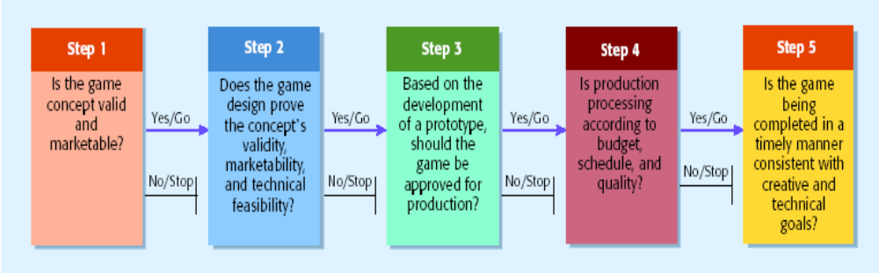
Product/Service Feasibility Analysis in Action
Role of feasibility analysis in the development of successful business ideas at Activision (u) Ltd (an electronic games company)
The Activision “Green Light Process”

Slide 74
2. Industry/Target Market Feasibility Analysis
It is an assessment of the overall appeal of the industry and the target market for the proposed business.
An industry is a group of firms producing a similar product or service.
A firm’s target market is the limited portion of the industry it plans to go after.
For industry/market feasibility analysis, there are three primary issues that a proposed business should consider:
Industry attractiveness,
market timeliness, and the
identification of a niche market.

Slide 75
a) Industry Attractiveness
Industries vary in terms of their overall attractiveness.
In general, the most attractive industries have the characteristics depicted on the next slide.
Particularly important is the degree to which environmental and business trends are moving in favor rather than against the industry .
In addition to evaluating an industry’s growth potential, a new venture will want to know more about the industry it plans to enter.
This can be accomplished through both primary and secondary research, as explained in the next slide.

Slide 76
Role of Primary and Secondary Research in Investigating Industry Attractiveness
Type of Research | How It Is Conducted
Primary research | This is research that is original and is collected by the entrepreneur. In assessing the attractiveness of a new market, this typically involves an entrepreneur talking to potential customers and key industry participants.
Secondary research | This is research that probes data that are already collected. Examples of where this data might come from are: industry-related publications, government statistics, competitor’s Web sites, and industry reports from research firms like Forrester Research
Market Timeliness Considerations
Nature of Product or Service Introduction | Major Considerations
Improvement on something already available in the marketplace | • Is the window of opportunity open or closed? • Is now a good time for a new market entrant (i.e. are customers buying, are industry incumbents making money?)
Breakthrough new product or service, which should establish a new market segment | • Should we try to capture a first-mover advantage or a second-mover advantage?

Slide 77
Entry Strategy For New Entry Exploitation
First Mover- Launching new to the world product or service or at least new to the market. (Pioneer advantage)
First mover faces less competitive rivalry
First movers can secure important channels
First movers are better positioned to satisfy customers
Above-average returns
Customer loyalty
An early hold on market share
Disadvantages of ‘Being First’
Demand Uncertainty: Considerable difficulty in accurately estimating the potential size of the market, how fast it will grow, and the key dimensions along which it will grow.
Technological Uncertainty: Considerable difficulty in accurately assessing whether the technology will perform and alternate technologies will emerge and leapfrog (game) over current technologies.
Uncertainty of Customers: Customers may have considerable difficulty in accurately assessing whether the new product or service provides value for them.

Slide 78
Second Mover –
Responds to first mover, typically through imitation
Is more cautious than first movers
Tends to study customer reactions to product innovations
Tends to learn from the mistakes of first movers, reducing its risks
Takes advantage of time to develop processes and technologies that are more efficient than first movers, reducing its costs
Reduce the entrepreneur’s costs associated with R&D.
Reduce customer uncertainty over the firm.
Late Mover –
Responds to market opportunities only after considerable time has elapsed since first and second movers have taken action
Has substantially reduced risks and returns

Slide 79
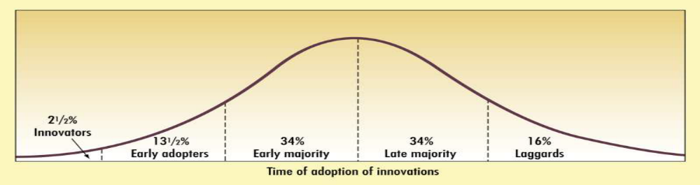
New Product Adopters Groups
Innovators- Venturesome, they try new ideas at some risks
Early adopters- they adopt new ideas early but carefully
Early majority- Adopt new ideas before average person
Late majority- Adopt new idea after a majority of people tried it.
Laggards- people suspicious to changes and adopt new product when it becomes some thing of a tradition itself (essential part of life)

Slide 80
Identification of a Niche Market: Niches do not 'exist' but are 'created' by identifying needs, wants, and requirements that are being addressed poorly or not at all by other firms.
For a new firm, selling to a niche market makes sense for at least two reasons.
It allows a firm to establish itself within an industry without competing against major competitors head on.
A niche strategy allows a firm to focus on serving a specialized market very well instead of trying to be everything to everybody in a broad market, which is nearly impossible for a new entrant.
b) Target Market Attractiveness
The challenge in identifying an attractive target market is to find a market that’s large enough for the proposed business but is yet small enough to avoid attracting larger competitors.

Slide 81
3. Organizational Feasibility Analysis
It is s concerned with determining whether the business itself has sufficient skills and resources to bring a particular product or service idea to market successfully.
Focuses on non-financial resources. There are two primary issues to consider in this area:
Management prowess.
Resource sufficiency.
a) Management Prowess
A firm should candidly evaluate the prowess, or ability, of its management team to satisfy itself that management has the requisite passion and expertise to launch the venture.
Two of the most important factors in this area are:
The passion that the solo entrepreneur or the founding team has for the business idea.
The extent to which sole entrepreneur or the founding team understands the markets in which the firm will participate.
Solo entrepreneurs or founding teams with established social and professional networks also have an advantage

Slide 82
Management Competence: An indication of passion is the willingness of a new venture team to complete comprehensive feasibility analysis.
b) Resource Sufficiency: This topic pertains to an assessment of whether an entrepreneur has sufficient resources to launch the proposed venture.
The focus here should be on nonfinancial resources in that financial feasibility is considered separately.
To test resource sufficiency, a firm should list the 6 to 12 most critical nonfinancial resources that will be needed to move the business idea forward successfully.
If critical resources are not available in certain areas, it may be impractical to proceed with the business idea.

Slide 83
Examples of nonfinancial resources that may be critical to the successful launch of a new business
Availability of affordable office or lab space.
Likelihood of local and state government support of the business.
Quality of the labor pool available.
Proximity to key suppliers and customers.
Willingness of high quality employees to join the firm.
Likelihood of establishing favorable strategic partnerships.
Proximity to similar firms for the purpose of sharing knowledge.
Possibility of obtaining intellectual property protection in key areas.

Slide 84
4. Financial Feasibility Analysis
For feasibility analysis, a quick financial assessment is usually sufficient. The most important issues to consider at this stage are:
Total start-up cash needed.
Financial performance of similar businesses.
Overall attractiveness of the proposed venture.
a) Total start-up cash needed: The first issue refers to the total cash needed to prepare the business to make its first sale.
An actual budget should be prepared that lists all the anticipated capital purchases and operating expenses needed to generate the first UGX 1 in revenues.
The point of this exercise is to determine if the proposed venture is realistic given the total start-up cash needed.
When projecting start-up expenses, it is better to overestimate rather than underestimate the costs involved.
Murphy’s Law is prevalent in the start-up world: “Things will go wrong. It is a rare start-up, that a business doesn’t have some setbacks in getting up and running”.

Slide 85
b) Financial Performance of Similar Businesses
Estimate the proposed start-up’s financial performance by comparing it to similar, already established businesses.
• There are several ways to doing this, all of which involve a little ethical detective work.
First, there are many reports available, some for free and some that require a fee, offering detailed industry trend analysis and reports on thousands of individual firms.
Second, simple observational research may be needed. For example, the owners of Namada Fitness Drinks (U) Ltd could estimate their sales by tracking the number of people who patronize similar restaurants and estimating the average amount each customer spends.

Slide 86
c) Overall Financial Attractiveness of the Proposed Investment
A number of other financial factors are associated with promising business startups.
In the feasibility analysis stage, the extent to which a business opportunity is positive relative to each factor is based on an estimate rather than actual performance.
Financial Factors Associated with Promising Business Opportunities
Steady and rapid growth in sales during the first 5 to 7 years in a clearly defined market niche.
High percentage of recurring revenue—meaning that once a firm wins a client, the client will provide recurring sources of revenue.
Ability to forecast income and expenses with a reasonable degree of certainty.
Internally generated funds to finance and sustain growth.
Availability of an exit opportunity for investors to convert equity to cash.

Slide 87
BUSINESS PLANNING
Planning is a process than never ends for a business. As the venture grows up to mature business, planning will continue …
A business plan is a written document prepared by the entrepreneur that describes all the relevant internal and external elements and strategies for starting a new venture.
A Business Plan is a document that conveys your organization’s prospects and growth potential. It describes:
  – You and your products and services
  – The market and your role in it
Shows you are committed to achieving a vision
Good follow-up to developing a strategic plan
Keeps focus on end product

Slide 88
Business Plan Drivers
Clear Vision of Purpose | The direction the business venture wants to achieve. A long term view
Clear Vision of Purpose | Exceptional customer service that results in the loyalty of customers, repeat purchases by them and greater customer retention.
Differentiate from Competitors | Positioning unique differentiating factors. Continuously making improvements to sustain a leadership position.
Resource Focus, Organization & Commitment to satisfy Customer needs | Resources should be optimally utilized to ensure that maximum possible value gets added to satisfy customer needs.

Slide 89
Why Have a Business Plan?
The business plan is valuable to the entrepreneur, potential investors, or even new personnel, who are trying to familiarize themselves with the venture, it goals, and objectives.
Clarify Direction: The primary purpose of a business plan is to define what the business is or what it intends to be over time.
Develop Vision: Businesses evolve and adapt over time, having vision for the future is important to business growth. Vision should adjust with changing times.
Attract Funding: A comprehensive business plan shows whether or not a business has the potential to make a profit.
Building Team: To build your core team, share your business plan with important candidates to help convince them of the potential for the business
Manage Company: Establish strategy and allocate resources according to strategic priority.
It helps determine the viability of the venture in a designated market

Slide 90
Presenting the Plan
It is often necessary for an entrepreneur to orally present the business plan before an audience of potential investors.
In this typical forum the entrepreneur would be expected to provide a short (perhaps 20-minutes or half-hour) presentation of the business plan.
Information Needs
Before committing time and energy to preparing a business plan, the entrepreneur should do a quick feasibility study of the business concept to see whether there a any possible barriers to success.
Internet can be a valuable resource.

Slide 91
Essential components of a business plan
Executive summary
Vision, mission, goals, objectives, core values
Business description
Products/ services
Organisation structure
Organisational plans
Production plan
Financial plan
i) Marketing plan
j) Operations plan
k) SWOT analysis
l) Conclusion
m) Appendices

Slide 92
Introductory Page
  Name and address of business
  Name(s) and address(es) of principal(s)
  Nature of business
  Statement of financing needed
  Statement of confidentially of report
Environmental and Industry Analysis
  Future outlook and trends
  Analysis of competitors
  Market segmentation
  Industry and market forecasts
Description of Venture
  Product(s)
  Service(s)
  Size of business
  Office equipment and personnel
  Background of entrepreneurs
Production Plan
  Manufacturing process (amount subcontracted)
  Physical plant
  Machinery and equipment
  Names of suppliers of raw materials
Executive Summary – Three to four pages summarizing the complete business plan
  What is the business concept or model?
  How is this business concept or model unique?
  Who are the individuals starting this business?
  How will they make money and how much?

Slide 93
Operational Plan
  Description of company’s operations
  Flow of orders for goods and/or services
  Technology utilization
Marketing Plan
  Pricing
  Distribution
  Promotion
  Product forecasts
  Controls
Organizational Plan
  Form of ownership
  Identification of partners or principal shareholders
  Authority of principals
  Management-team background
  Roles and responsibilities of members of organization
Assessment of Risk
  Evaluate weakness of business
  New technologies
  Contingency Plans
Financial Plan
  Pro forma income statement
  Cash flow projections
  Pro forma balance sheet
  Break-even analysis
  Sources and applications of funds
Appendix (contains backup material)
  Letters
  Market research data
  Leases or contracts
  Price lists from suppliers.

Slide 94
Measuring Plan Progress:
Entrepreneur should check the
profit and loss statement,
cash flow projections, and
information on inventory, production, quality, sales, collection of accounts receivable, and
disbursements for the previous month.
You need to institute:
  Inventory control
  Production control
  Quality control
  Sales control
  Disbursements
Updating the Plan
The most effective business plan can become out-of-date if condition change.
If the change are likely to affect the business plan, the entrepreneur should determine what revisions are needed.
In this manner, the entrepreneur can maintain reasonable targets and goals and keep the new venture on a course that will increase probability of success.

Slide 95
Why Some Business Plans Fail
Goals set by the entrepreneur are unreasonable.
Goals are not measurable
The entrepreneur has not made a total commitment to the business or to the family.
The entrepreneur has no experience in the planned business.
The entrepreneur has no sense of potential threats or weaknesses to the business.
No customer need was established for the proposed product or service.

